Slide 1

Please Sign In. Thank you!
The following were distributed with the Tuesday Talk and Friday Announcements emails:
● Proposed Constitutional Amendments
● Proposed Budget
● 2018 Annual Report
● Bios of Candidates
● Minutes from Jan 28th and April 8th Congregational Meetings
● Organizational Chart
● List of Potential Share The Plate Partners
A limited number of copies are available at the sign in table.
Please reference electronic copies, when possible.

Slide 2
First Unitarian Universalist Church
Annual Meeting
June 3, 2018

Slide 3
Welcome and Announcement
of Quorum
Judy Vazquez, Moderator

Slide 4
Opening Words - Rev. Marian Stewart
Memorial Moment - Rev. Eric Meter

Slide 5
Board of Trustees Report
Carolee Noonan, Board Chair

Slide 6
2018 – 2019 Budget Report
Jeff Boughton, Treasurer

Slide 7
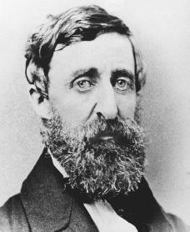
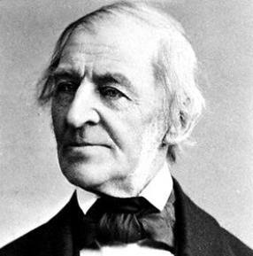
Looks like a tough crowd Ralph.
Wait ‘til they see the budget Henry.

Slide 8
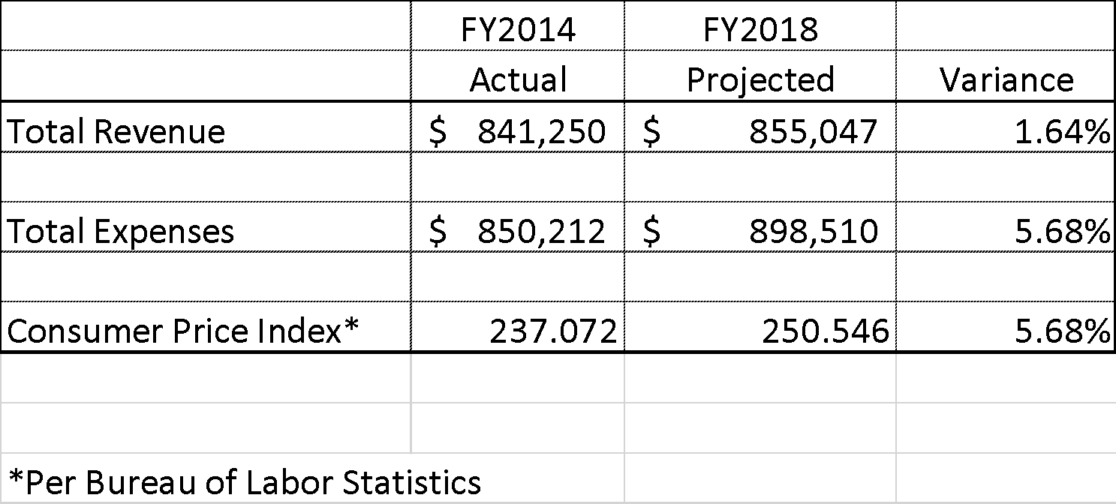
5 Year Comparison

Slide 9
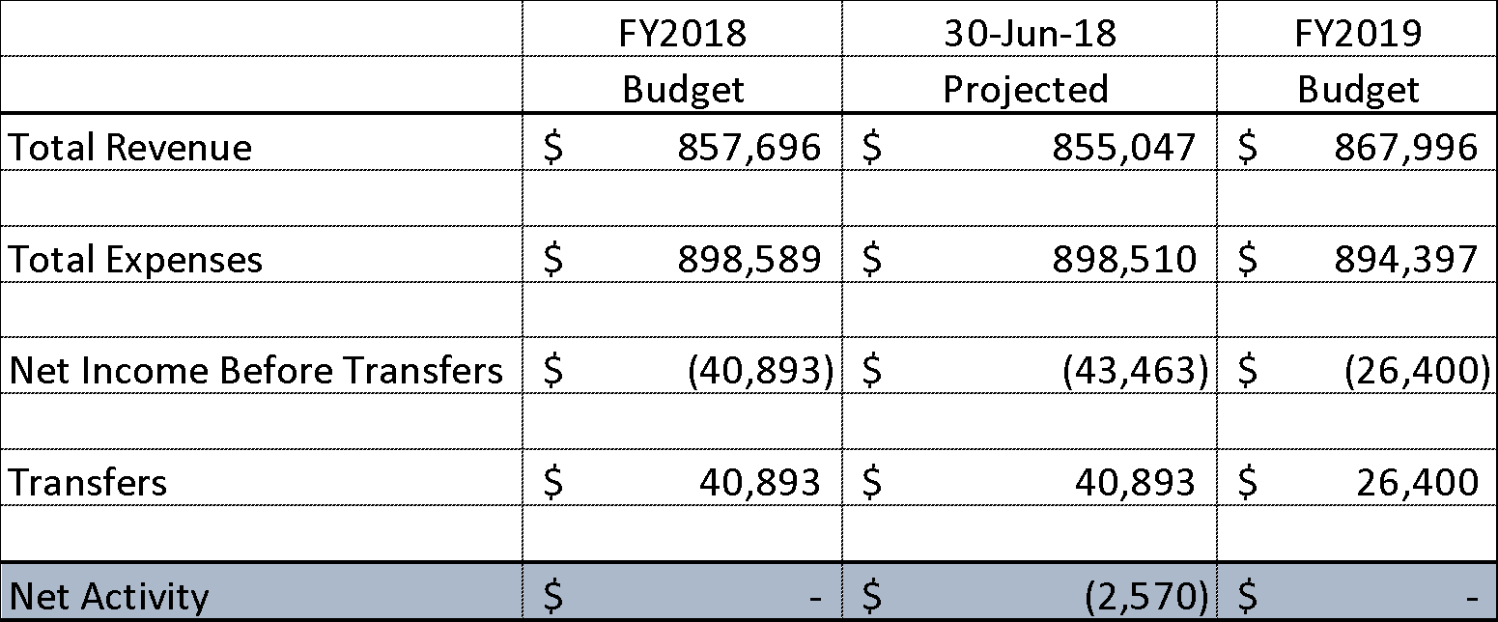
Summary

Slide 10
A word about Transfers
Endowment Fund transfers:
  Fund principal unaffected
  should enhance the mission of First UU
  Board approved
Restricted Fund transfers:
  for the designated purpose
  purpose is no longer valid
  donor approved

Slide 11
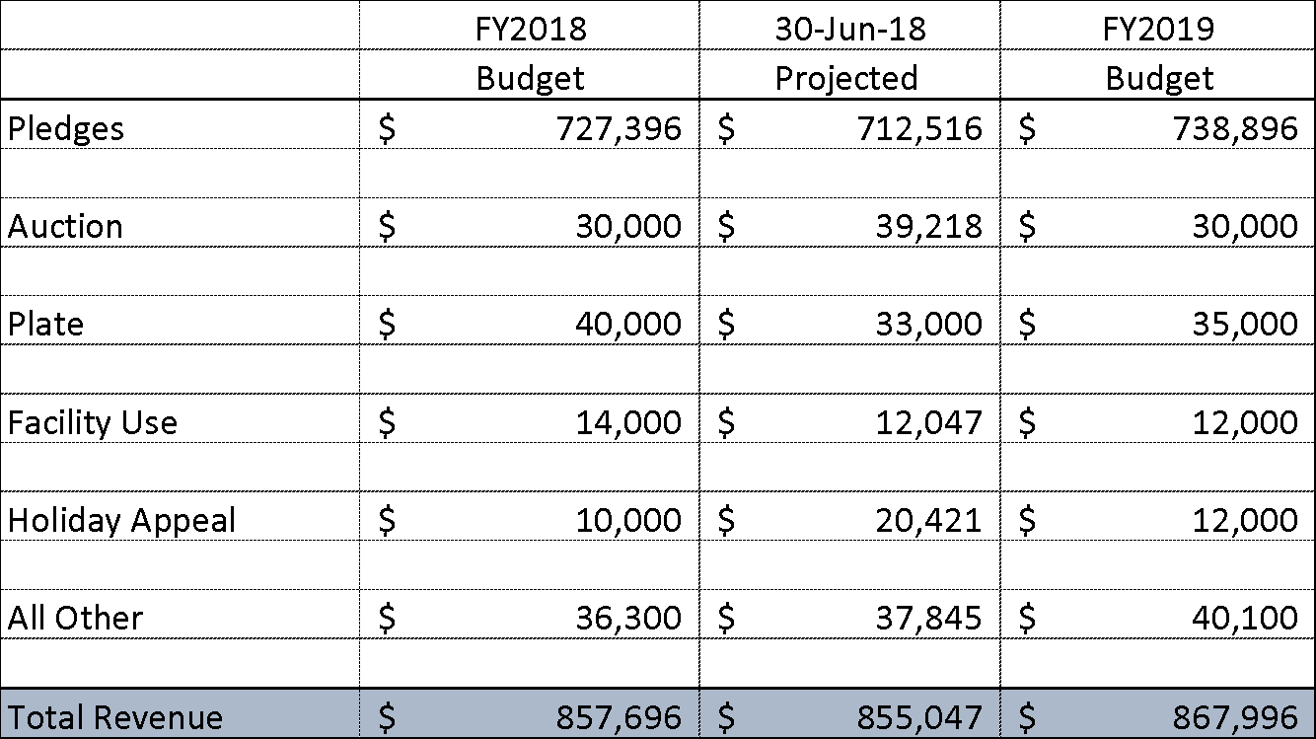
Revenue Budget Breakdown

Slide 12
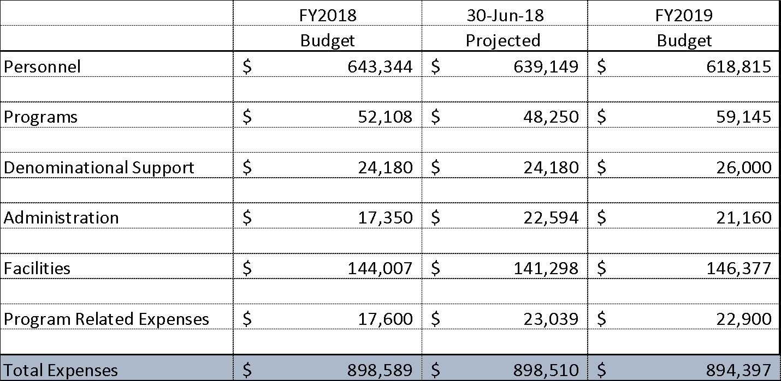
Expense Budget Breakdown

Slide 13
Mid-year Goals - Update
Deficit
Facility Funding
Fair Salaries
Denominational Support
Ministerial Intern

Slide 14
Approval of Budget by Voice Vote
Judy Vazquez, Moderator

Slide 15
Green and Growing Capital Campaign
Bob Mills and Kitty Jones

Slide 16


Slide 17
Review and Discussion of
Constitutional Changes
Seth Kraut, Board Vice-Chair

Slide 18
Constitutional Changes
Clean up
  Region name
  DRE/MRE
  Religious Exploration
  Partnership Governance
    Teams
  Other
Absentee Voting
Board Governance Policy

Slide 19
Region Name
ARTICLE I - ESTABLISHMENT OF THE CHURCH
…
5. This church shall encourage and support the Unitarian Universalist Association and the Central East Region Ohio-Meadville District of the Unitarian Universalist Association.

Slide 20
Religious Exploration
ARTICLE III - MEMBERSHIP
2. Any person sixteen (16) years of age, or older, who is prepared to make a commitment of time, energy and financial support to the church, may sign the membership book in the presence of a Minister of this church, the Director (or Minister) of Religious Education Exploration, a member of the Board of Trustees, or the chair of the Membership Committee. Persons from the age of fourteen (14) to sixteen (16) years, who have successfully completed a coming of age or other transition or preparatory program/curriculum approved by the Religious Education Exploration Council, and who are prepared to make the same commitment, may sign the membership book following the same procedures. Each new member may choose to participate in a welcome ceremony at a regular worship service.

Slide 21
Cleanup on Membership
ARTICLE III - MEMBERSHIP
5. All members shall be expected to contribute financially to the extent of their ability. Members in situations of hardship may be excused from financial responsibilities to the church upon approval of one of the ministers.
For the guidance of members, the Board of Trustees shall establish and make known suggested levels of giving which it deems appropriate to:
A. Maintain a member on the rolls, send the newsletter, and pPay contributions to the Unitarian Universalist Association and the Central East Region Ohio-Meadville District of the Unitarian Universalist Association.; and,
B. pProvide funds for basic operational expenses for facilities, staffing and programming and outreach. ; and,
C. sSupport capital fund drives.
D. Members in situations of hardship may be excused from financial responsibilities to the church upon approval of one of the ministers.

Slide 22
More Cleanup on Membership
6. Discontinuing Membership
…
B. The Board of Trustees may discontinue the membership of an individual member, in consultation with the Stewardship and Membership Teams Committees, and the Minister(s). Discontinuation of membership shall be based on one or more of the following conditions:
1. The church is unable to maintain contact or the church is unable to find a current address for with the member after repeated attempts to contact that individual. by personal and written means.
2. The church is unable to identify a financial contribution to the church for one year and the member has not been by a member at or above the minimum established by the Board of Trustees. Members in hardship may be excused from financial responsibilities to the church by a minister.

Slide 23
Youth Representatives
ARTICLE V - MEMBER ELECTED LEADERSHIP
1. BOARD OF TRUSTEES
…
B. In addition to the six members specified in section 1. A. above, the youth of the church (14 to 19 years of age) shall select one or two a youth to serve as a representative to the Board of Trustees. The youth representative shall serve a one-year term, beginning July 1 and running through June 30 of the following year.

Slide 24
Clean up Board Action
J. Any action taken by the Board of Trustees may be reversed by a vote of a 2/3 of the members of this church present and voting at any properly called meeting, where a quorum is present as specified in Article IV, Section 3 5, called within 30 days after the receipt by the membership of the effective notification of the related action so taken. If the members so reverse an action of the Board of Trustees, such Board action shall be null and void.

Slide 25
Moderator Term
ARTICLE V - MEMBER ELECTED LEADERSHIP
…
2. MODERATOR
The Moderator shall be elected by the members of the church at the Annual Meeting for a one year term, and shall take office at the beginning of the new fiscal year. The sole duty of the Moderator shall be to preside over the business meetings and any special meetings of the church.

Slide 26
Grammar
2. Upon the adoption of a motion by at least a two-thirds (2/3rd) vote of the Board or upon receipt by the Board of a petition bearing the signatures of at least fifteen percent (15%) of the church membership last reported to the UUA, the Board promptly shall call a congregational meeting to consider recall of any member of the Board of Trustees named in such motion or petition. A vote by at least two-thirds (2/3rd) of the members present at such a meeting at which a quorum is present shall result in the immediate recall from office of the named person. The vacancy shall be filled by the Board as set forth in C.1. above.

Slide 27
Teams
ARTICLE VIII - THE MINISTER(S)
…
5. Ministers shall have freedom of the pulpit and shall work cooperatively with the Board of Trustees in promoting the purpose and principles of the church. The Minister(s) shall be ex-officio non-voting member(s) of the Board of Trustees and all committees and teams of the church, except the Nominating Committee.

Slide 28
Clean up
6. Ministers shall be responsible for the following functions, and in consultation with the Board of Trustees, they shall determine their several roles: worship; religious growth, exploration and education; pastoral care; social concerns and justice actions; administration, including supervision of paid staff. In a collegial relationship, the Minister(s) shall clearly delineate and communicate responsibility, accountability, and channels of communication before assuming their respective responsibilities led by the Senior Minister.

Slide 29
Interim Minister Search
7. The decision to seek an interim minister to serve during the time when the church is searching for a new settled minister shall be made by a majority of the membership present and voting at a business meeting or at a special meeting called for that purpose. Following a positive vote, the Board of Trustees shall be empowered to appoint a search committee for an interim minister, which shall include representation from the membership at large, in addition to representatives from the Board of Trustees. The interim search committee shall function according to the procedures established by the Unitarian Universalist Association Office of Ministerial Settlement (or its equivalent) or by other means deemed appropriate by the Board of Trustees.
Notes:
Delete this paragraph as it duplicates and conflicts with Article V, Section 4 “The Search Committee for a Consulting, Interim or Settled Minister”

Slide 30
Interim Minister Search
4. THE SEARCH COMMITTEE FOR A CONSULTING, INTERIM OR SETTLED MINISTER
A. The search committee for a consulting, interim or settled minister shall select a candidate as a consulting, interim or settled minister of the church. A consulting minister or interim shall be hired by the Board under such terms as the Board and the consulting or interim minister shall determine. The Board shall determine whether to seek a consulting, interim or a settled minister. A settled minister candidate shall be voted upon by the membership, in accordance with Article VIII, Section 1.

Slide 31
Absentee Voting

Slide 32
Absentee Voting
ARTICLE IV - MEETINGS OF THE MEMBERSHIP AND/OR CONGREGATION
1. There shall be two business meetings each fiscal year.
Notes:
Context for the absentee voting sections

Slide 33
Absentee Voting
A. The Annual Meeting shall be held between May 1 and June 15. The day and hour and agenda of each Annual Meeting shall be set by the Board of Trustees. The agenda shall include (but not be limited to): year-end reports, Nominating Committee report and elections, unfinished and new business, and the adoption of the annual budget. Items to be voted on, other than new business, shall be so designated. Absentee voting will be made available prior to the meeting; however, absentee votes will not be counted if the motion upon which the congregation votes is amended during the meeting. See Article VII.5

Slide 34
Absentee Voting
B. A mid-year business meeting shall be held before March 1 of each year. The day and hour and agenda shall be set by the Board of Trustees. The agenda shall include (but not be limited to): a discussion of goals, program and budget issues. Items to be voted on, other than new business, shall so be designated. Absentee voting will be made available prior to the meeting; however, absentee votes will not be counted if the motion upon which the congregation votes is amended during the meeting.

Slide 35
Absentee Voting
ARTICLE VII - THE NOMINATING COMMITTEE AND ELECTIONS
5. All elections shall be by secret written ballot except in those cases where there are no opposing candidates. For the benefit of homebound members or those with other special circumstances, aAn absentee voting procedure may be developed for elections.

Slide 36
Absentee Voting
ARTICLE VIII - THE MINISTER(S)
1. The membership shall call all settled ministers for the church. The minister(s) shall be called by a two-thirds vote of the church members present and voting at a meeting of the membership, called for that purpose, and shall continue to serve during mutual satisfaction. For the benefit of homebound members or those with special circumstances, aAn absentee voting procedure may be developed for calling a minister.

Slide 37
Absentee Voting
ARTICLE XII – AMENDMENTS
1. Amendments to this Constitution may be proposed by the Board of Trustees or by written petition signed by a group equal to the quorum, who are members of the church.
Notes:
Context

Slide 38
Absentee Voting
2. Amendments shall be adopted by a two-thirds vote of members of the church present and voting in-person or absentee at a business meeting or special meeting called for that purpose. Written notice of the exact text of such proposed amendments, by means of the church newsletter, electronic distribution, posting on the church website or otherwise, shall be given to each member of the church at least 30 days prior to the meeting.

Slide 39
Board Governance Policies
ARTICLE V - MEMBER ELECTED LEADERSHIP

Slide 40
Board Governance Policies
D. The Board of Trustees may adopt, for its government, Governance Policies Standing Rules not in consistent with this Constitution. Notice of the proposed adoption of any Standing Rules shall be given the congregation through the church newsletter not fewer than ten days prior to the meeting of the Board of Trustees at which such action is scheduled for a vote. Any aAmendments to the Governance Policies Standing Rules which have been adopted by the Board of Trustees shall be reported in the church newsletter. The Secretary of the Board of Trustees shall assure that an updated copy of the Constitution and Governance PoliciesStanding Rules are posted on the church bulletin board and the church website at all times.

Slide 41
Remove Executive Committee
G. The Executive Committee of the Board of Trustees shall consist of the chair, vice-chair, secretary, immediate past board chair, and other person(s) designated by the board chair. Unless otherwise authorized by the Board, the authority of the executive committee shall be to plan all board meeting agendas and to make decisions with regard to matters that must be dealt with before the next scheduled meeting of the Board. All such actions must be reviewed for ratification by the Board at the next meeting of the Board of Trustees.

Slide 42
Governance Policy
ARTICLE VIII - THE MINISTER(S)
3. An interim minister or consulting minister may be dismissed by the Board of Trustees without a vote of the congregation according to procedures established in a Governance Policy Standing Rule duly adopted by the Board.

Slide 43
Partnership
ARTICLE IX - COMMITTEES AND TEAMSCOUNCIL(S), COMMITTEES, APPOINTMENTS
1. In partnership, Tthe Board of Trustees, Ministers and senior staff shall establish the organizational structure and delegate responsibility and authority to carry out the activities of the church for which the Board is responsible. Lines of responsibility for Board committees and church supported organizations shall be determined by the Board. All church positions and responsibilities are defined in the Governance Policies Standing Rules.

Slide 44
No Church Council
2. A Church Council(s) structure to include Chairs (or their representatives) of all standing and special committees shall be established by the Board. The major purpose of the Council(s) is to coordinate programming for First Church as outlined in the Standing Rules. The Coordinator of the Council(s) and/or designee, will report regularly to the Board.

Slide 45
Governance Policy
3. In accordance with Article V, 4. B., the Chair of a Search Committee will be appointed according to the procedures established by the office of ministerial settlement of the Unitarian Universalist Association as such procedures are in place at the time. The Chairs of all other committees, as well as individual positions, shall be appointed by the Board of Trustees after recommendation from members of the congregation the Council(s). Information on composition, appointment, and duties are set forth in the Governance Policies Standing Rules and Standard Operating Procedures.

Slide 46
Governance Policy
ARTICLE X - PARLIAMENTARY AUTHORITY
The rules contained in the current edition of Robert’s Rules of Order, newly revised, shall govern the First Unitarian Universalist Church of Columbus in all cases to which they are applicable and not inconsistent with this Constitution, the Governance Policies Standing Rules, and any special rules of order adopted.

Slide 47
Nominating Committee Report
Kay Gaskill

Slide 48
Voting for:
Board of Trustees
Nominating Committee Members
Constitutional Changes
Judy Vazquez, Moderator

Slide 49
Senior Minister Report
Rev. Marian Stewart

Slide 50
Sr. Minister Report
First Year

Slide 51
First, a look under the hood…
Are there patterns we need to pay attention to?

Slide 52
Churches and Life Cycles
Are there opportunities in the patterns?

Slide 55
1976
=518
2011
=641
July 2017 578
May 2018 595

Slide 56
How are we organized?
What do our structures say about our focus?

Slide 58
Is there another way to see it?
Can our vision be front and center?

Slide 59
The VISION of
First Unitarian Universalist Church of Columbus
is to
transform and heal ourselves and our world
through reason and love.

Slide 60
With love at the center,
the MISSION of this church is to fulfill its vision by…
Creating community
through
caring, nurturing, and celebrating
Engaging diversity
through
welcoming, listening, and empowering
Working for justice
through
learning, reflecting, and doing

Slide 61
CONGREGATION
Plus all of us,
the partners…
MINISTRY
GOVERNANCE

Slide 63
So…who and what fits where?
The backside of the Partnership Chart

Slide 66
Tell me again why we do this?
Where are we going?
What are we trying to do?

Slide 67
The VISION of
First Unitarian Universalist Church of Columbus
is to
transform and heal ourselves and our world
through reason and love.

Slide 68
Our deepest fear is not that we are inadequate.
Our deepest fear is that we are powerful beyond measure.
It is our light, not our darkness that most frightens us.
—Marianne Williamson

Slide 69
Associate Minister Report
Rev. Eric Meter

Slide 70
D/M RE Search Committee:
Patricia Boughton, chair
Winston Basso-Shirker
John Grinstead
Ruby Linhan
Cindy Whicker

Slide 71
Introducing our next
Director of Religious Exploration…

Slide 72
Elizabeth Mount

Slide 73
Minister of Religious Exploration Report
Rev. Lane Campbell

Slide 74
Ministerial Intern Report
Focused Initiative: Beloved Conversations
Amanda Hays

Slide 75
Director of Administration Report
Brian Hagemann

Slide 76
Results of Ballot Voting
Candidates by Kay Gaskill,
Nominating Committee
Constitutional Amendment
Seth Kraut, Board Vice-Chair

Slide 77
Introduction of
New Youth Board Members
Jhalez Caldwell-Craig
and Lilly Colegrove
by Nate Blake

Slide 78
Extinguish the Chalice
Jhalez, Lilly & Nate

Slide 79
The End.
Thank you for being a caring and active member of this congregation!

Slide 80
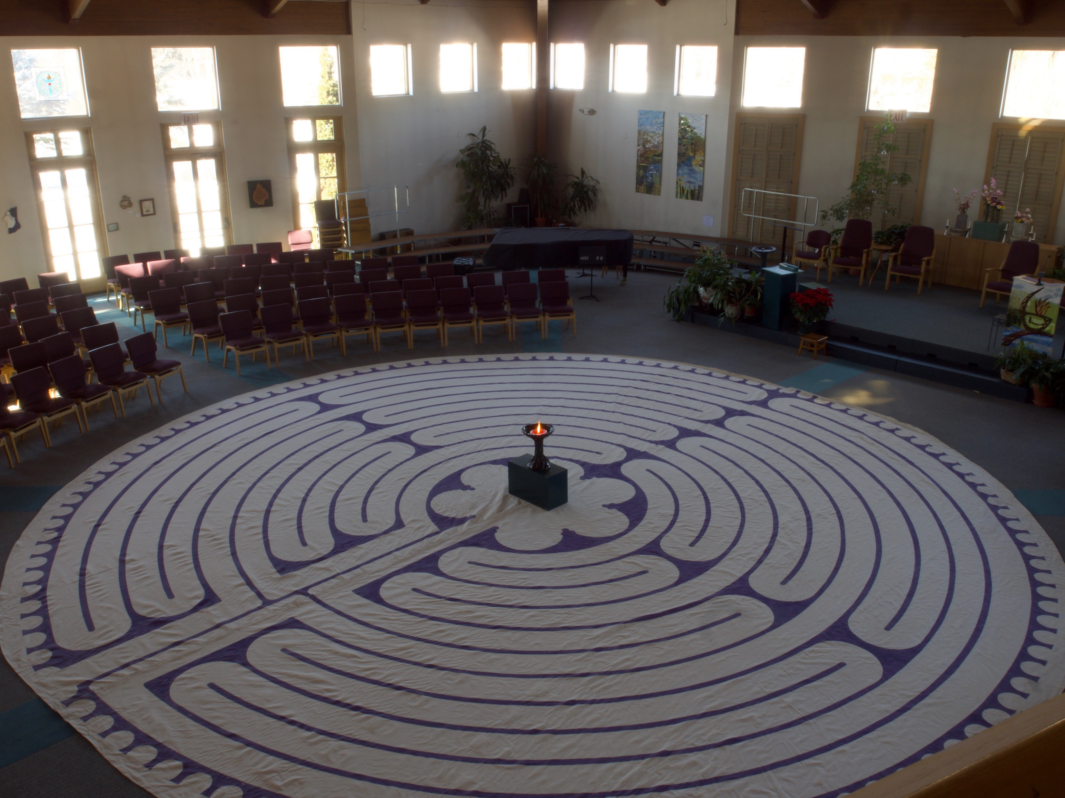
Thank you for being a caring and active member of this congregation.

